Slide 1
Organizational Structure & Review Process - Jan 2025
Building a Structured Path for Growth

Slide 2
Work From Home Policy Update - 2025
We Value Your Feedback
At Es Magico Tech Studio, your feedback is instrumental in shaping our workplace policies.
We're committed to fostering a supportive and flexible work environment.
Why This Change?
Reflects our commitment to continuous improvement based on employee feedback.
Empowers you to plan WFH days more effectively and balance personal and professional priorities.
Key Update to the WFH Policy
Effective Date: 1st January 2025
Previous Policy:
WFH allowance was distributed quarterly.
Unused WFH balance could not be accrued in the next quarter.
New Policy:
Magicians can now accrue their WFH balance.
Accumulated WFH balance can be utilized together for greater flexibility.

Slide 3
Structure

Slide 4
Addressing and Improving Current Structure Challenges
Designations will be more uniform across the team.
Roles and responsibilities at all levels will be clearly defined.
Clear pathways for career advancement will be established.
Structured professional development opportunities will be provided.
Juniors will have access to mentorship and knowledge-sharing from seniors.
Cross-project collaboration and knowledge sharing will be promoted.
Feedback mechanisms will be introduced for continuous improvement.
Alignment with organizational goals will ensure streamlined communication.
Chapter leads will be created for each domain: Web, BE, Mobile, PM, Design, DevOps, and AI.

Slide 5
Suggested Engineering, Product, and Design Structuring
# | Engineering |  |  | Product | Design
 | Individual Contributor | Engineering Manager | QA
L9 | CTO |  |  | CPO
L8 | VP, Engineering |  |  | VP, Product | VP, Design
L7 | Principal Engineer | Principal Engineering Manager | Principal QA | Principal Product / Project Manager | Principal Designer
L6 | Senior Staff Engineer | Senior Engineering Manager | Senior QA | Senior Product / Project Director | Senior Design Director
L5 | Staff Engineer | Engineering Manager | Staff QA | Product / Project Director | Design Director
L4 | Senior Software Engineer 2 |  | Senior QA - 2 | Senior Product / Project Manager - 2 | Senior Designer - 2
L3 | Senior Software Engineer 1 |  | Senior QA - 1 | Senior Product / Project Manager - 1 | Senior Designer - 1
L2 | Software Engineer 2 |  | QA - 2 | Product / Project Manager - 2 | Designer - 2
L1 | Software Engineer 1 |  | QA - 1 | Product / Project Manager - 1 | Designer - 1
L0 | Intern |  | Intern | Intern | Intern

Slide 6
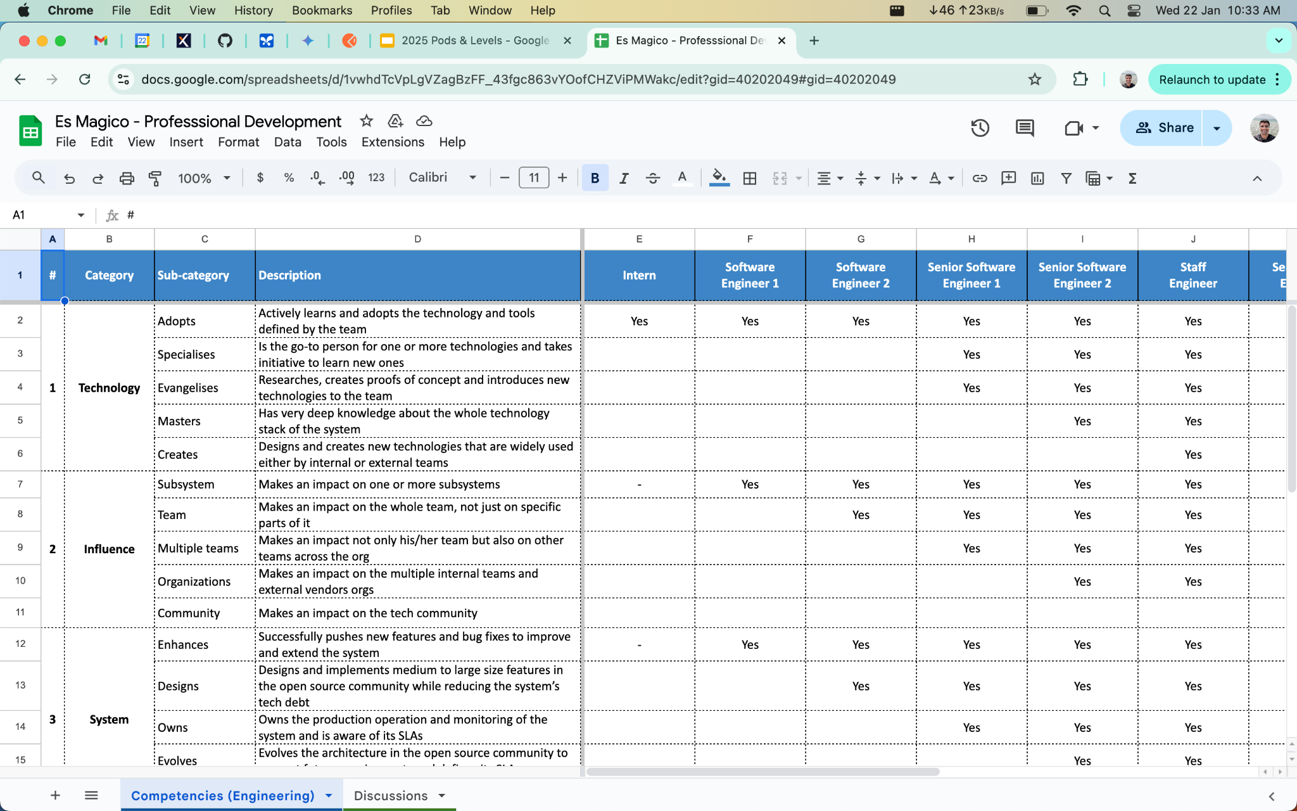

Slide 7
Chapters & Leads
Sr. No. | Lead | Chapter
1 | Shreyas Sanghvi | Design
2 | Shreyas Sanghvi | Product
3 | Aniket Dandagavhan | Backend
4 | Ankit Patidar | Frontend
5 | Kanhaiya Singh | Mobile
6 | Aakash Satpute | Quality Engineer

Slide 8
Next steps
All magicians will be aligned to the above designation structure across Engineering - Dev + QA, Product and Design.

Slide 9
Execution

Slide 10

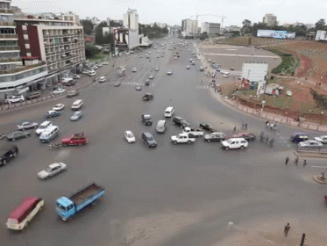

Currently…
What’s our current way of execution?

Slide 11
Making Execution Better
PODs - Autonomous teams containing Web, BE, Mobile, Devops, AI, PM and Design experts
Each pod working focussed on dedicated projects
Each pod has a leader managing intra-pod requirements
Uniform sprints across the organization
Org level sprint planning for planning and execution excellence

Slide 12
Focus | Venture Studio |  | AI & Products |  | Static Services
Product Managers (Pod Leads) | Shainaa Pal | Aditya Verma | Shivansh Dania | Lakshmi Narayana
Backend Engineers | Pratik | Shreyash Sahre | Aniket | Abhishek | Jaanbaaz
 | Kishan | Sanchit | Dhruv | Rohit Kedia | Amruth Vamshi
 | Saraswati | Avani | Aditya A | Khalid
 |  | Jaanbaaz |  | Ajay
 |  | Somshubhro
Frontend Engineers | Ankit Kumar | Shanoor | Ankit Patidar | Prateek | Tushar
 | Deepak | Faisal | Vishal
 | Tushar
Mobile Application Developers | Kanhaiya |  | Chandrakala | Sanoj | Ashish
 | Vittal |  | Kushagra | Ishika | Shakti
 | Ritesh |  |  | Harsh
 |  |  |  | Ashish
Quality Engineers | Ankush |  | Aakash
 | Edwin | Ravina | Kaif
AI |  |  | Anvansh | Vidisha
Devops | Gaurav | Rakesh | Srijan | Srijan
 | Hemanth
Design | Mitali | Debashish | Akshay A | Debashish | Hitiksha

Slide 13
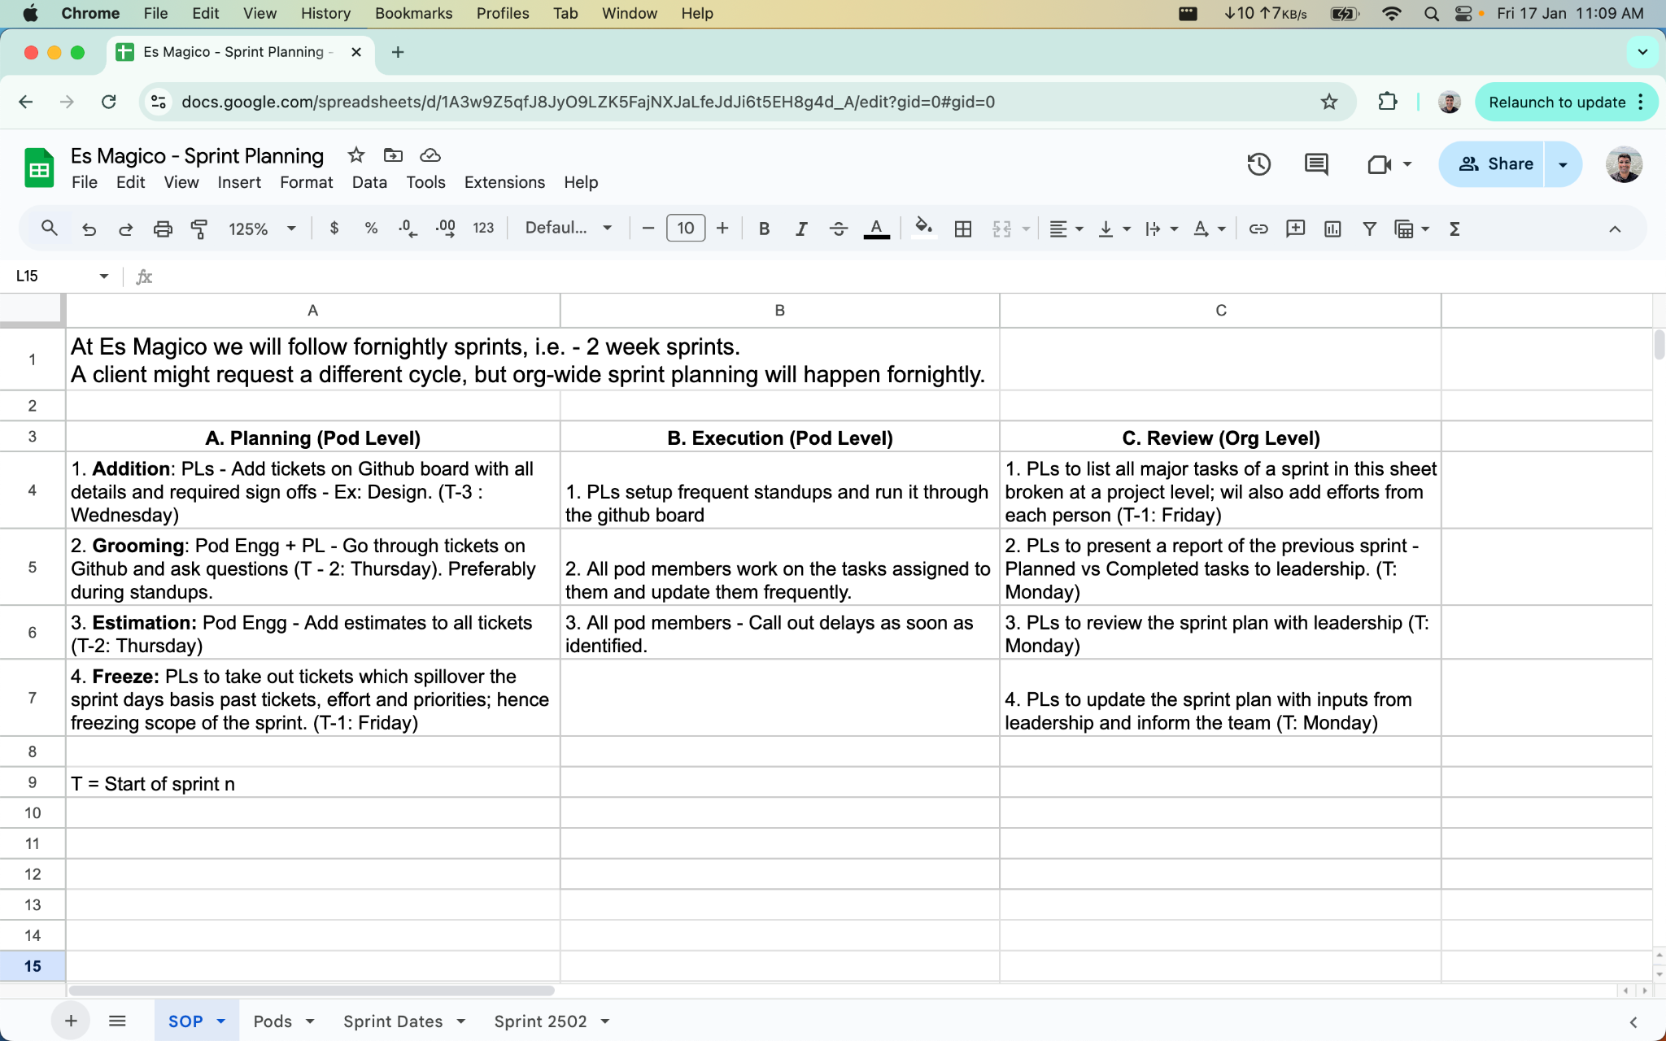

Slide 14
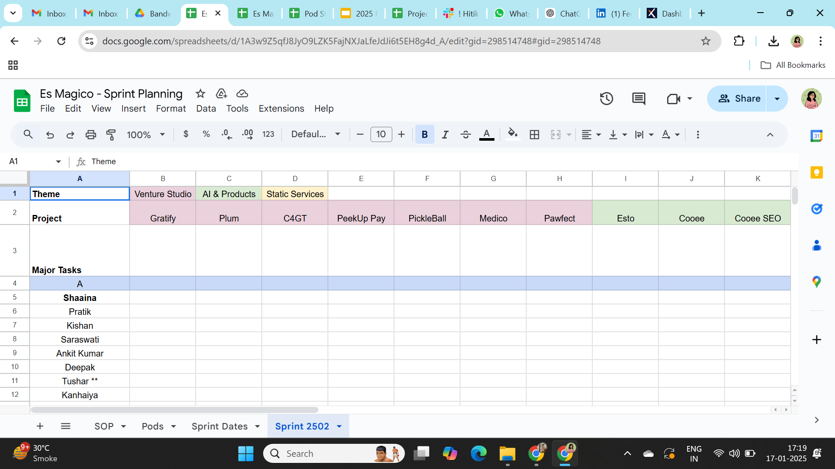
Sprint Planning Sheet

Slide 15

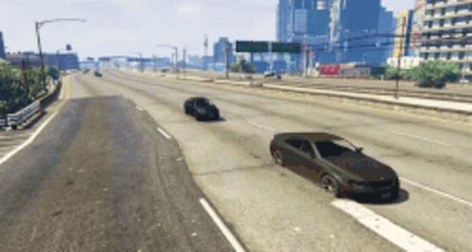

Future…

Slide 16
Timelines

Slide 17
Timelines
Structuring
January 24th, 2025: Designation alignments emails sent to everyone as per current roles & responsibilities.
January 24th, 2025: Chapter leads discussion
January 28th, 2025: Designations updated on Razorpay
Execution
January 22nd, 2025: Pod structure released
January 24th, 2025: Call with pod leaders about execution processes
Jan - Feb, 2025: Transitions

Slide 18
Next Policy
Performance Review & Ratings

Slide 19
Key Milestones for Structural Changes
Yearly Review, Increment & Promotion
March: Annual performance reviews.
Effective 1st April.
Mid-Point Review
September: Exceptional cases for promotion & increment.
Effective 1st October.
Monthly One-on-One with Managers
Regular updates to keep track of:
Performance feedback.
Reporting manager changes (for upcoming policy).

Slide 20
Thank you!

